Slide 1

Chapter 6 Concurrency: Deadlock and Starvation

Slide 2
CS 345
Stalling’s Chapter | # | Project
1: Computer System Overview 2: Operating System Overview | 4 | P1: Shell
3: Process Description and Control 4: Threads | 4 | P2: Tasking
5: Concurrency: ME and Synchronization 6: Concurrency: Deadlock and Starvation | 6 | P3: Jurassic Park
7: Memory Management 8: Virtual memory | 6 | P4: Virtual Memory
9: Uniprocessor Scheduling 10: Multiprocessor and Real-Time Scheduling | 6 | P5: Scheduling
11: I/O Management and Disk Scheduling 12: File Management | 8 | P6: FAT
Student Presentations | 6

Slide 3
Learning Objectives…
Learning Outcomes
After completing this section, you should be able to
List and explain the conditions of deadlock.
Define deadlock prevention and describe deadlock prevention strategies related to each of the conditions for deadlock.
Explain the difference between deadlock prevention and deadlock avoidance.
Understand how an integrated deadlock strategy can be designed.
Analyze the dining philosophers problem.
Explain the concurrency and synchronization methods used in UNIX, Linux, Solaris, and Windows 7.
Topics
Resources
Deadlock
Joint Process Diagrams
Deadlock Conditions
Circular Wait
Resource Allocation Graph
Handling Deadlock
Avoidance
Detection
Recovery

Slide 4
Quiz 6.1
Deadlock
How could deadlock occur when
200K bytes of memory is available for allocation by the system
Process 1 needs 140K in 80K, 60K blocks
Process 2 needs 150k in 70K, 80K blocks
How could deadlock occur when
Two processes need to communicate via send/receive messages
Process 1 waits to hear from process 2 before sending data
Process 2 proceeds after hearing from process 1
Notes:
4

Slide 5
Types of Resources
Resources
Reusable Resources
Used by one process at a time and not depleted by that use
Processes obtain resources that they later release for reuse by other processes
Processor time, I/O channels, main and secondary memory, files, databases, and semaphores
Deadlock occurs if each process holds one resource and requests the other
Consumable Resources
Created (produced) and destroyed (consumed) by a process
Interrupts, signals, messages, and information in I/O buffers
Deadlock may occur if a Receive message is blocking
May take a rare combination of events to cause deadlock
Notes:
5

Slide 6
Follow the Rules…
Deadlock
System Model (Rules)
Process must request (and be granted) a resource before using it.
Process must release the resource when done.
Why??
Deadlock
A set of processes is in a deadlock state when every process in the set is waiting for an event that can only be caused by another process in the set.
P1: holds R1, needs R2
P2: holds R2, needs R3
P4: needs R1
P3: holds R3, needs R1
Notes:
6

Slide 7
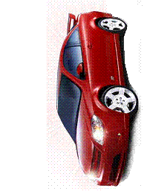







Deadlock
Quiz 6.2
What are the resources?
Where is mutual exclusion needed?
What is required for deadlock to occur?
Notes:
7

Slide 8
Joint Process Diagram
Diagrams
Progress
of Q
1
2
Impossible joint
conditions are
grayed out.
Release A
Both P and Q
have A
A
Required
Release B
Get A
B
Required
5
?
Both P and Q
have B
P has B
Q has A
P has B
Q has A
4
Get B
Deadlock is only inevitable if the joint progress of the two processes creates a path that enters the fatal region.
6
3
Progress
of P
Get A
Get B
Release A
Release B
A Required
B Required
Notes:
8

Slide 9
Joint Process Diagram
Diagrams
Progress
of Q
1
2
3
Release
A
Both
P and Q
have A
6
A
Required
Release
B
Get A
Both
P and Q
have B
B
Required
5
Get B
4
Progress
of P
Get A
Release A
Get B
Release B
No fatal region, as there are “exit” paths available.
A
Required
B
Required
Notes:
9

Slide 10
Conditions of Deadlock
Necessary Conditions
Necessary (but not sufficient)
Mutual exclusion – Everyone abides by the rules
only one process may use a resource at a time.
no process may access resource allocated to another.
Hold-and-wait
a process may hold allocated resources while awaiting assignment of other resources.
No preemption
no resource can be forced to free a resource.
Circular wait (sufficient)
a closed chain of processes exists, such that each process holds at least one resource needed by the next process in the chain (consequence of the first three conditions)
Other conditions are necessary but not sufficient for deadlock - all four conditions must hold for deadlock - Unresolvable circular wait is the definition of deadlock!
Notes:
10

Slide 11
Circular Wait
Circular Wait
Resource
A
Requests
Held by
Process
P1
Process
P2
Held By
Requests
Resource
B
Notes:
11

Slide 12
Describing Deadlock
Resource Allocation Graph
Deadlocks can be described using resource allocation graph
Vertices
Active processes {P1, P2, … }
Resources {R1, R2, … }
Edges
A directed edge from Pi to Rj
Process Pi requested an instance of resource Rj
A directed edge from Rj to Pi
Resource Rj has been allocated to process Pi
Process are circles, resources are rectangles
Notes:
12

Slide 13
Resource Allocation Graph
Resource Allocation Graph
R1
R2
Process are circles, resources are rectangles
A directed edge from Pi to Rj indicates process Pi has requested an instance of resource Rj
P1
P2
P3
A directed edge from Rj to Pi indicates resource Rj has been allocated to process Pi
R3
R4
Notes:
13

Slide 14
Resource Allocation Graph
Resource Allocation Graph
R1
R2
Is there a cycle?
If a graph contains no cycles, then no process in the system is deadlocked
P1
P2
P3
If the graph contains a cycle, deadlock MAY exist
R3
Is there deadlock?
R4
Notes:
14

Slide 15
Handling Deadlock
Handling Deadlock
Four general approaches exist for dealing with deadlock.
Prevent deadlock
by adopting a policy that eliminates one of the conditions
Avoid deadlock
by making the appropriate dynamic choices based on the current state of resource allocation
Detect Deadlock
by checking whether conditions 1 through 4 hold and take action to recove
Ignore Deadlock
System may hang, so??
Notes:
15

Slide 16
Prevention by Elimination
Handling Deadlock
Eliminate Mutual Exclusion
Use non-sharable resources
Eliminate Hold and wait
Guarantee that when a process requests a resource, it does not hold any other resources
System calls requesting resources precede all others
A process can only request resources when it has none
Usually results in low utilization of resources
Allow Preemption
If a process holds resources and requests more that cannot be allocated, all its other resources are preempted
If you can’t hold all, you can’t hold any
Process is restarted only when it can have all
Works for resources whose state can be easily saved and restored later such as registers or memory.
Notes:
16

Slide 17
Prevention by Elimination
Handling Deadlock
Eliminate Circular Wait
Impose a total ordering of all resources (transitivity, antisymmetry)
Require that all processes request resources in increasing order.
Whenever a process requests a resource, it must release all resources that are lower
With this rule, the resource allocation graph can never have a cycle.
May be impossible to find an ordering that satisfies everyone
1 ≡ Card reader
2 ≡ Printer
3 ≡ Plotter
4 ≡ Tape drive
5 ≡ Card punch
Processes request resources whenever, but must be made in numerical order.
A process may request first printer and then a tape drive (order: 2, 4), but not a plotter and then a printer (order: 3, 2).
Notes:
17

Slide 18
Deadlock Avoidance
Avoidance
Allow general requests, but grant only when safe
Assume we know the maximum requests (claims) for each process
Process must state it needs
Ie. max of 5 A objects, 3 B objects, 2 C objects.
Do not need to use its max claims
Ie. Ok to set max=5 and only use 3
Can make requests at any time and in any order
Process Initiation Denial
Track current allocations
Assume all processes may make maximum requests at the same time
Only start process if it can’t result in deadlock regardless of allocations
Notes:
18

Slide 19
Resource Allocation Denial
Avoidance
Safe State – We can finish all processes by some scheduling sequence
Example: Finish P1, P4, P2, P5, P3
Banker’s Algorithm (Dijkstra)
Reject a request if it exceeds the processes’ declared maximum claims
Grant a request if the new state would be safe
Determining if a state is safe
Find any process P_{i} for which we can meet it’s maximum requests
Don't forget already allocated resources
Mark P_{i} as “done”, add its resources to available resource pool
State is safe if we can mark all processes as “done”
Block a process if the resources are not currently available or the new state is not safe
Notes:
19

Slide 20
Avoidance Example
Avoidance
Claim
Allocation
Allocation
C - A
 | A | B | C
P₁ | 3 | 2 | 2
P₂ | 6 | 1 | 3
P₃ | 3 | 1 | 4
P₄ | 4 | 2 | 2
A
A
B
C
A
B
B
C
C
P₁
P₁
2
2
2
P₁
1
1
0
0
0
0
P₂
P₂
1
0
2
P₂
5
5
1
1
1
1
P₃
P₃
1
0
3
P₃
2
2
1
1
1
1
P₄
P₄
4
2
0
P₄
0
0
0
0
2
2
Resource
A | B | C
9 | 3 | 6
Available
A | B | C
1 | 1 | 2
Are we in a safe state?
Yes!

Slide 21
Quiz 6.3
Avoidance
Carpentry Company XYZ has 4 employees, 9 clamps, 2 drills, and 2 bottles of glue.
Chair 4 clamps, 1 drill
Desk 6 clamps, 1 drill, 1 glue
Picture Frame 4 clamps, 1 drill, 1 glue
Book Case 6 clamps, 1 drill, 1 glue

Slide 22
Quiz 6.3
Avoidance
Claim
Allotted
Needed
 | Clamp | Drill | Glue
P₁ | 4 | 1 | 0
P₂ | 6 | 1 | 1
P₃ | 4 | 1 | 1
P₄ | 6 | 1 | 1
 | Clamp | Drill | Glue
P₁ | 1 | 0 | 0
P₂ | 2 | 0 | 1
P₃ | 2 | 1 | 0
P₄ | 2 | 0 | 0
A
B
C
P₁
3
1
0
P₂
4
1
0
P₃
2
0
1
P₄
4
1
1
Resource
Clamp | Drill | Glue
9 | 2 | 2
Available
Clamp | Drill | Glue
2 | 1 | 1
1. Are we in a safe state?
2. P₁ needs a drill. Is it OK to give it to him?
3. Then, P₄ needs a glue. Would you give it to him?

Slide 23
Quiz 6.3
Avoidance
Claim
Allotted
Needed
 | Clamp | Drill | Glue
P₁ | 4 | 1 | 0
P₂ | 6 | 1 | 1
P₃ | 4 | 1 | 1
P₄ | 6 | 1 | 1
 | Clamp | Drill | Glue
P₁ | 1 | 1 | 0
P₂ | 2 | 0 | 1
P₃ | 2 | 1 | 0
P₄ | 2 | 0 | 0
A
B
C
P₁
3
0
0
P₂
4
1
0
P₃
2
0
1
P₄
4
1
1
Resource
Clamp | Drill | Glue
9 | 2 | 2
Available
Clamp | Drill | Glue
2 | 0 | 1
P₄ needs a glue. Would you give it to him (still safe state)?
No!

Slide 24
Quiz 6.3
Avoidance
Claim
Allotted
Needed
 | Clamp | Drill | Glue
P₁ | 4 | 1 | 0
P₂ | 6 | 1 | 1
P₃ | 4 | 1 | 1
P₄ | 6 | 1 | 1
 | Clamp | Drill | Glue
P₁ | 1 | 1 | 0
P₂ | 2 | 0 | 1
P₃ | 2 | 1 | 0
P₄ | 2 | 0 | 1
A
B
C
P₁
3
0
0
P₂
4
1
0
P₃
2
0
1
P₄
4
1
0
Resource
Clamp | Drill | Glue
9 | 2 | 2
Available
Clamp | Drill | Glue
2 | 0 | 0
If you give P₄ the glue, are we then deadlocked?
No!

Slide 25
Deadlock Detection
Detection
Avoidance methods tend to limit access to resources
Instead, grant arbitrary requests and watch for deadlock
Can vary how often we check
Early detection vs. overhead of checks
Algorithm (Stallings, Figure 6.9)
Preparation:
Create table of process requests, current allocations
Note available resources
Mark processes with no resources
Mark any process whose requests can be met (requests ≤ available resources)
Include resources from that process as ‘available’ (this process can finish)
If multiple processes available, pick any
If any processes cannot be marked, they are part of a deadlock
Notes:
25

Slide 26
Detection Example
Detection
Request
Allocation
Resource
 | A | B | C | D | E
P₁ | 0 | 1 | 0 | 0 | 1
P₂ | 0 | 0 | 1 | 0 | 1
P₃ | 0 | 0 | 0 | 0 | 1
P₄ | 1 | 0 | 1 | 0 | 1
 | A | B | C | D | E
P₁ | 1 | 0 | 1 | 1 | 0
P₂ | 1 | 1 | 0 | 0 | 0
P₃ | 0 | 0 | 0 | 1 | 0
P₄ | 0 | 0 | 0 | 0 | 0
A | B | C | D | E
2 | 1 | 1 | 2 | 1
Available
A | B | C | D | E
0 | 0 | 0 | 0 | 1
A
B
C
D
E
Temporary Available
0
0
0
0
0
0
0
1
1
1
Mark P₄ (not holding anything someone else wants)
Mark P₃, new available: 0 0 0 1 1
Cannot mark P₁ or P₂, so we are deadlocked

Slide 27
Quiz 6.4
Detection
Requests
Allocation
Resource
 | A | B | C
P₁ | 0 | 0 | 0
P₂ | 2 | 0 | 2
P₃ | 0 | 0 | 0
P₄ | 1 | 0 | 0
P₅ | 0 | 0 | 2
 | A | B | C
P₁ | 0 | 1 | 0
P₂ | 2 | 0 | 0
P₃ | 3 | 0 | 3
P₄ | 2 | 1 | 1
P₅ | 0 | 0 | 2
A | B | C
7 | 2 | 6
Available
A | B | C
0 | 0 | 0
A
B
C
Temporary Available
0
0
0
Are we deadlocked? (Why or why not?)

Slide 28
Deadlock Detection Questions?
Detection
Does it really work?
How often should you run a detection process?
How often is deadlock likely to occur?
How expensive is the detection process?
Notes:
28

Slide 29
Deadlock Recovery
Recovery
Several possible approaches
Abort all deadlocked processes
Simple but common
Back up processes to a previously saved checkpoint, then restart
Assumes we have checkpoints and a rollback mechanism
Runs risk of repeating deadlock
Assumes that the deadlock has enough timing dependencies it won’t happen
Selectively abort processes until deadlock broken
Preempt resources until deadlock broken
Must roll back process to checkpoint prior to acquiring key resource
Notes:
29

Slide 30
Deadlock Recovery
Recovery
Process Termination
Kill them all
One at a time
Consider priority
Time computing
Who has most resources
Resource Preemption
Who gets preempted
Do you consider process rollback and starvation
Notes:
30

Slide 31
Mixed Strategy
Recovery
May group resources into classes, have a different deadlock strategy for each class
Swap Space
Prevent deadlocks by requiring all space to be allocated at once
Avoidance also possible
Tapes/Files
Avoidance can be effective here
Prevention by ordering resources also possible
Main Memory
Preemption a good approach
Internal Resources (channels, etc.)
Prevention by ordering resources
Can use linear ordering between classes
Notes:
31

Slide 32
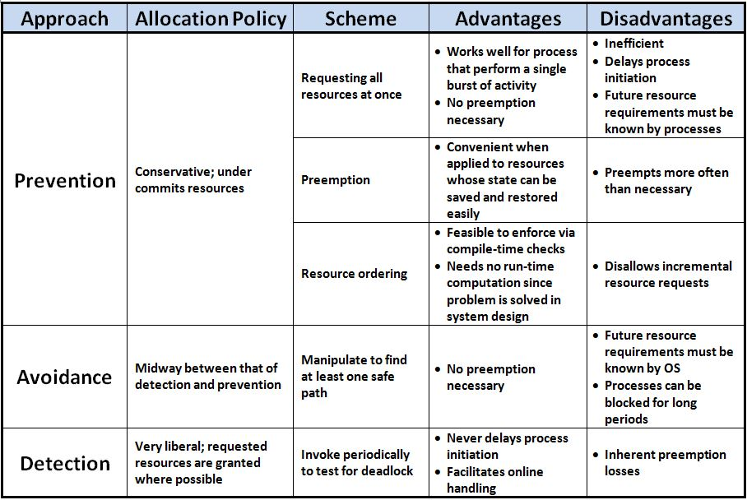
Advantages/Disadvantages

Slide 33
Advantages/Disadvantages
Approach | Allocation Policy | Scheme | Advantages | Disadvantages
Prevention | Conservative; under commits resources | Requesting all resources at once | Works well for process that perform a single burst of activity No preemption necessary | Inefficient Delays process initiation Future resource requirements must be known by processes
 |  | Preemption | Convenient when applied to resources whose state can be saved and restored easily | Preempts more often than necessary
 |  | Resource ordering | Feasible to enforce via compile-time checks Needs no run-time computation since problem is solved in system design | Disallows incremental resource requests
Avoidance | Midway between that of detection and prevention | Manipulate to find at least one safe path | No preemption necessary | Future resource requirements must be known by OS Processes can be blocked for long periods
Detection | Very liberal; requested resources are granted where possible | Invoke periodically to test for deadlock | Never delays process initiation Facilitates online handling | Inherent preemption losses

Slide 34
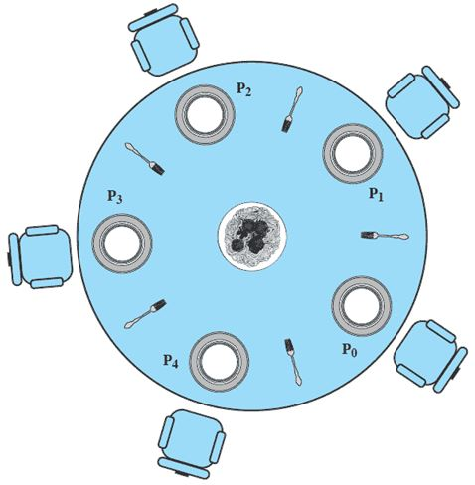
Quiz 6.5
Dining Philosophers
5 philosophers who only eat and think.
Each need to use 2 forks for eating.
There are only 5 forks.
1. Two philosophers are eating. Are we in a safe state?
2. Is deadlock possible?
3. How can deadlock be prevented?

Slide 35
The Dining Philosophers Problem
Dining Philosophers
5 philosophers who only eat and think.
Each need to use 2 forks for eating.
There are only 5 forks.
Classical synchronization problem.
Illustrates the difficulty of allocating resources among process without deadlock and starvation.

Slide 36
Solution??
Dining Philosophers
Process Pi:
repeat
think;
wait(forks[i]);
wait(forks[(i+1)%5]);
eat;
signal(forks[(i+1)%5]);
signal(forks[i]);
forever
Each philosopher is a process.
One semaphore per fork:
forks: array[0..4] of semaphores
Initialization: forks[i].count:=1 for i:=0..4
Deadlock if each philosopher starts by picking left fork!
Notes:
Philosophers eat and think for a random amount of time.
(They are not self-aware. ha ha)
Can’t proceed if my right fork has been picked up.
Mutual exclusion
Bounded wait problem
Progress
Possible Solutions:
Only one allowed to pick up forks. If not available, put back down. (All or nothing)
2. Only allow four people to pick up – guarantees at least one to succeed.

Slide 37
Another Solution
Dining Philosophers
A solution: admit only 4 philosophers at a time that tries to eat
Then 1 philosopher can always eat when the other 3 are holding 1 fork
Introduce semaphore T that limits to 4 the number of philosophers “sitting at the table”
Initialize: T.count:=4
Process Pi:
repeat
think;
wait(T);
wait(forks[i]);
wait(forks[(i+1)%5]);
eat;
signal(forks[(i+1)%5]);
signal(forks[i]);
signal(T);
forever
Notes:
T allows only 4 people in.
Maybe not the most efficient

Slide 38
Other Solutions…
Dining Philosophers
Buy more Forks
Equivalent to increasing resources
Put fork down if 2nd fork busy
“livelock” if philosophers stay synchronized
Room Attendant
Only let 4 of the philosophers into the room at once
May have 4 philosophers in room, but only 1 can eat
Left-Handed Philosophers (asymmetric solution)
Grab forks in the other order (right fork, then left fork)
Any mix will avoid deadlock (linear ordering on forks)
A philosopher may only pick up forks in pairs.
must allocate all resources at once

Slide 39
